Slide 1
Connecting to the Internet Through an ISP
Networking for Home and Small Businesses – Chapter 4

Slide 2
Objectives
Explain “what is the Internet?” and how we connect to the Internet using an Internet Service Provider (ISP).
Explain how information is sent across the Internet through an ISP.
Describe and identify the components of an ISP Network Operations Center.
Identify the different types of cables and connectors for connecting the devices in a Network Operations Center.
Construct and terminate twisted pair cables and determine type of cable needed

Slide 3
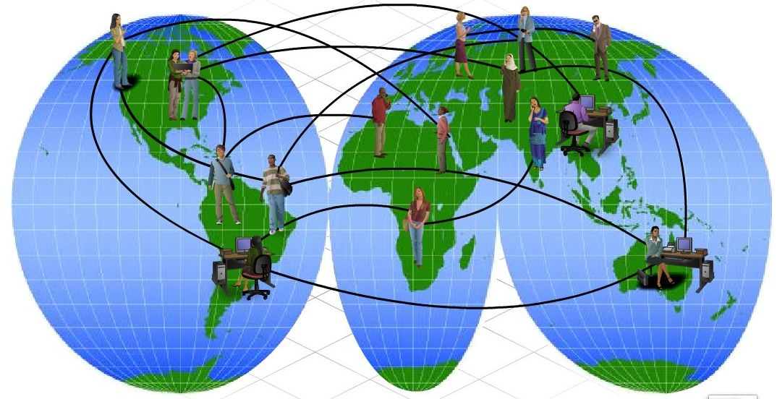
The Internet and How We Connect to It Using an ISP
Explain what the Internet is

Slide 4
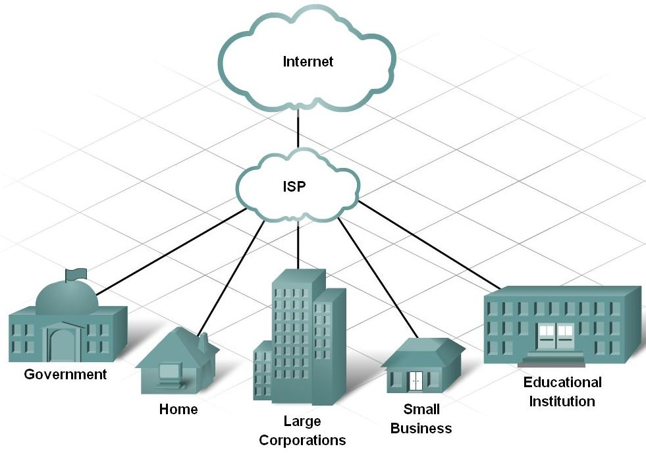
The Internet and How We Connect to It Using an ISP
Define an Internet Service Provider and its purpose

Slide 5
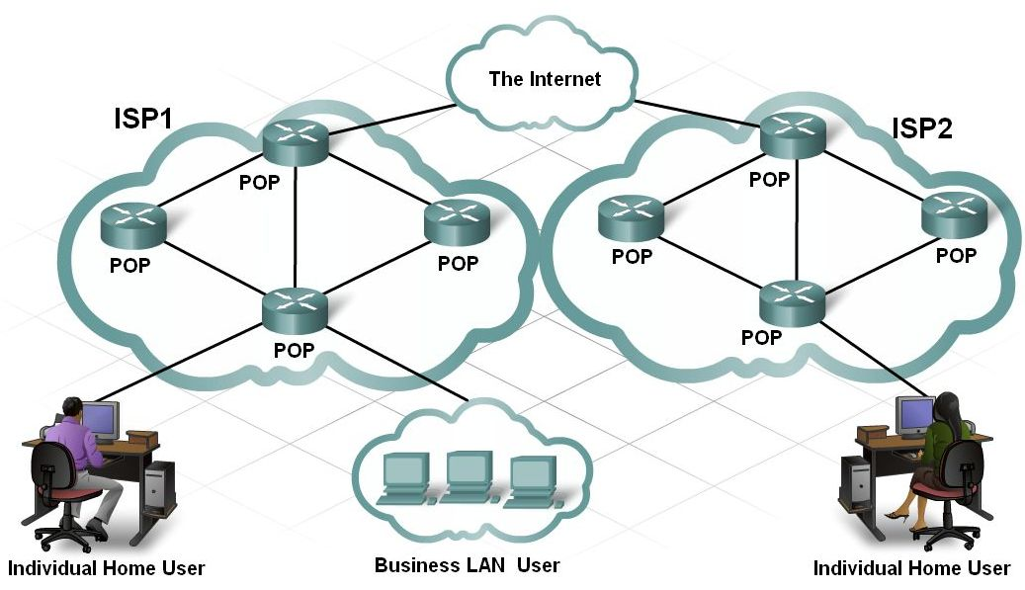
The Internet and How We Connect to It Using an ISP
Describe how you connect to the Internet through the ISP and the ISP’s relationship to the Internet

Slide 6
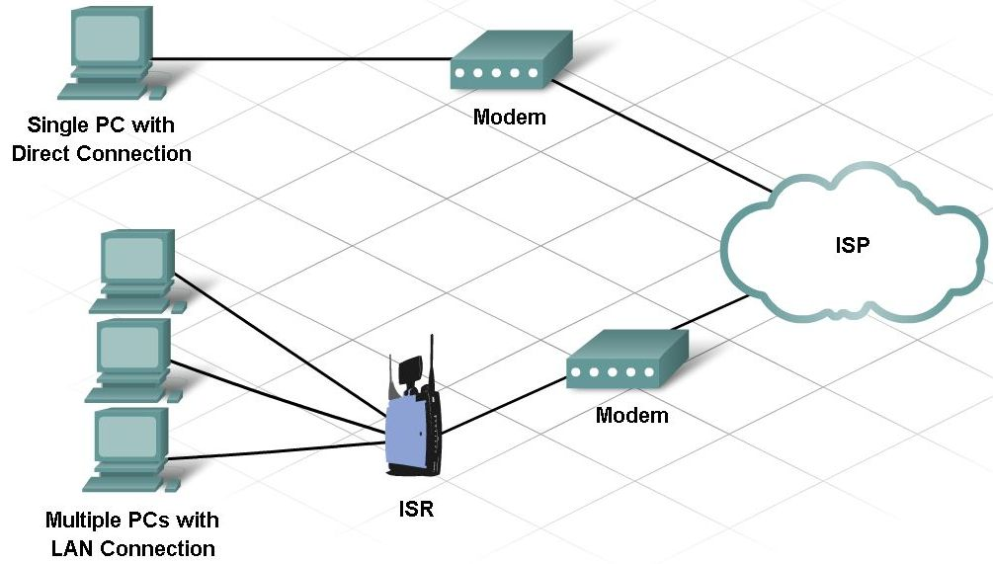
The Internet and How We Connect to It Using an ISP
Identify and describe the different connection options that ISPs can provide

Slide 7
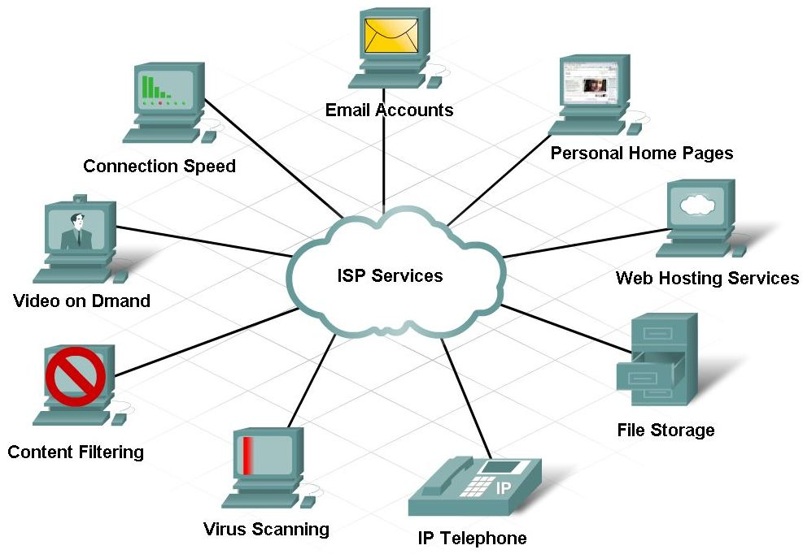
The Internet and How We Connect to It Using an ISP
Identify and describe the levels of service offered by an ISP

Slide 8
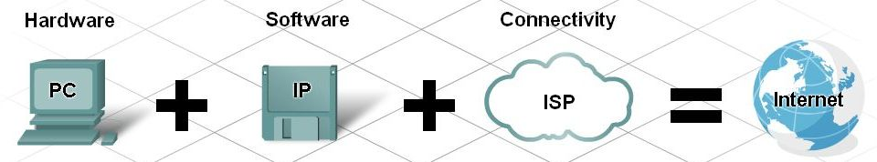
How Information is Sent When Using an ISP
Define and explain that the most important protocol of the Internet is the Internet Protocol (IP).

Slide 9
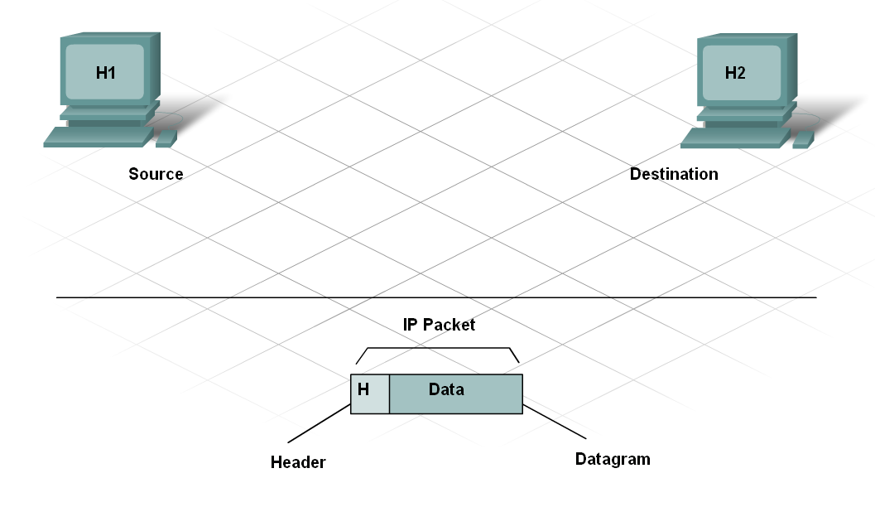
How Information is Sent When Using an ISP
The IP Packet

Slide 10
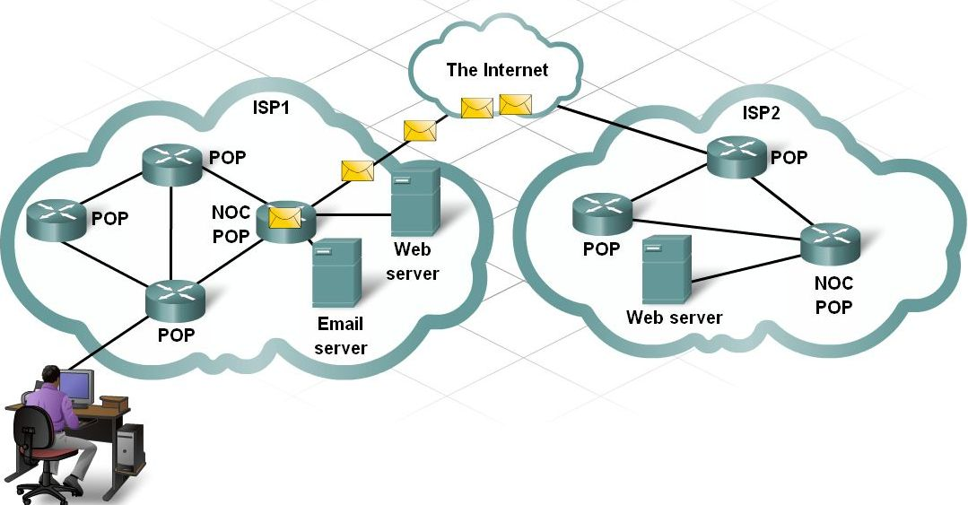
How Information is Sent When Using an ISP
Explain how the ISP NOC handles packets from your home network

Slide 11
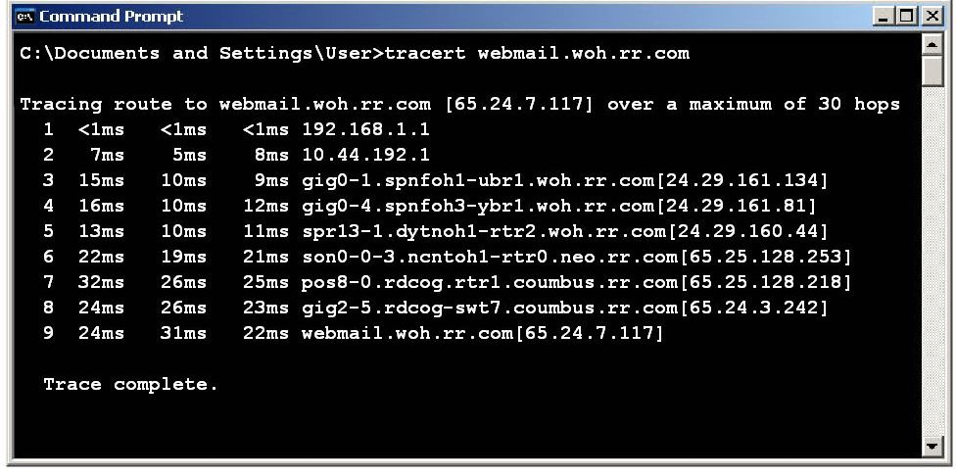
How Information is Sent When Using an ISP
Describe how the ISP forwards packets across the Internet

Slide 12
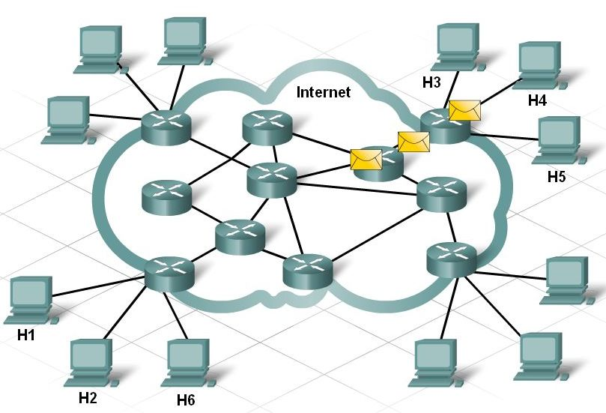
The Internet Cloud
Identify and describe the concept of the Internet cloud.

Slide 13
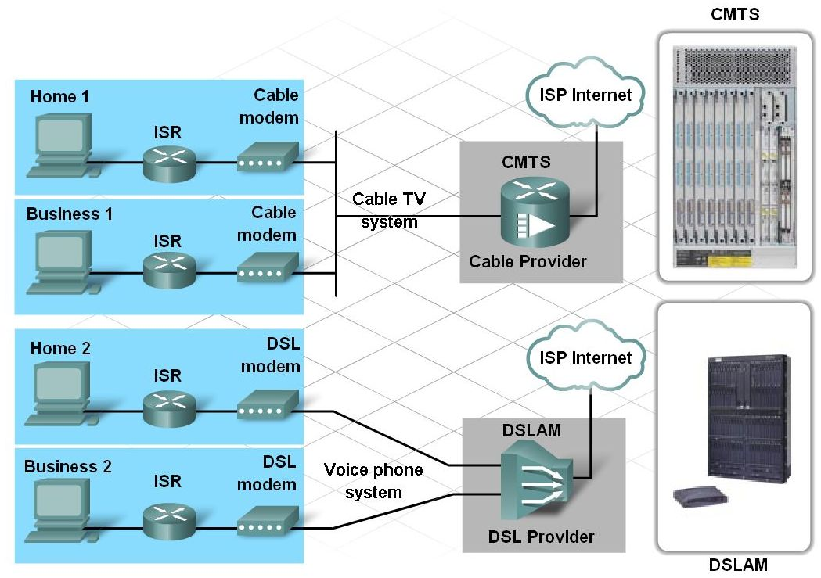
Components of an ISP Network Operations Center
Identify and describe the network devices used in a NOC within the Internet cloud

Slide 14
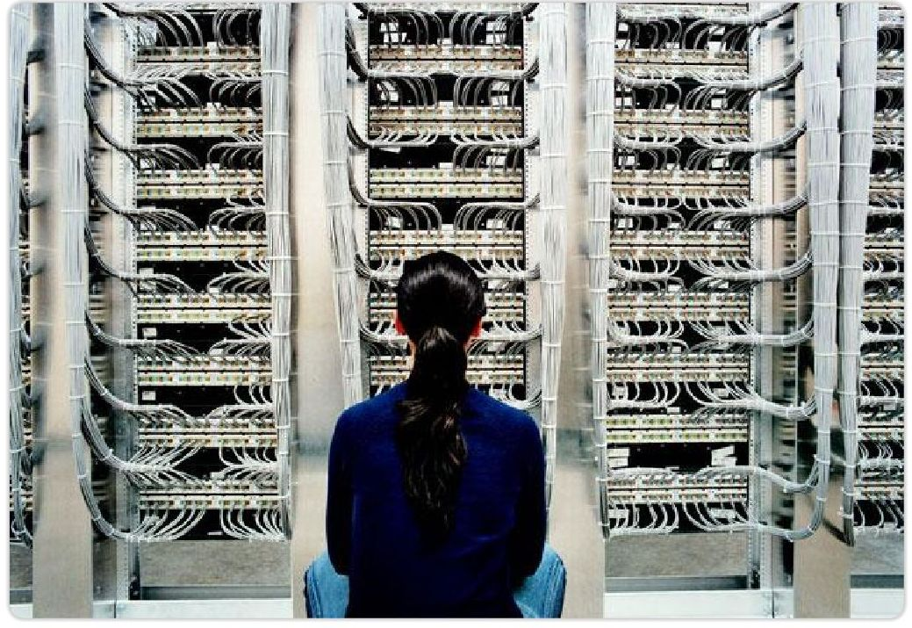
Components of an ISP Network Operations Center
Physical requirements of a home network versus an ISP

Slide 15
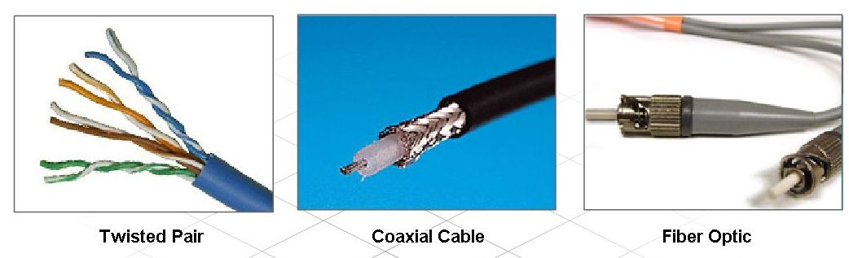
Types of Cables and Connectors Used in Networking
Identify and describe common types of cables

Slide 16
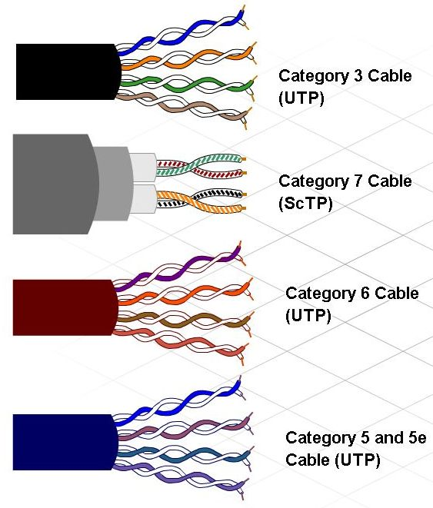
Types of Cables and Connectors Used in Networking
Describe twisted pair cables, common terminations, and when they are used

Slide 17
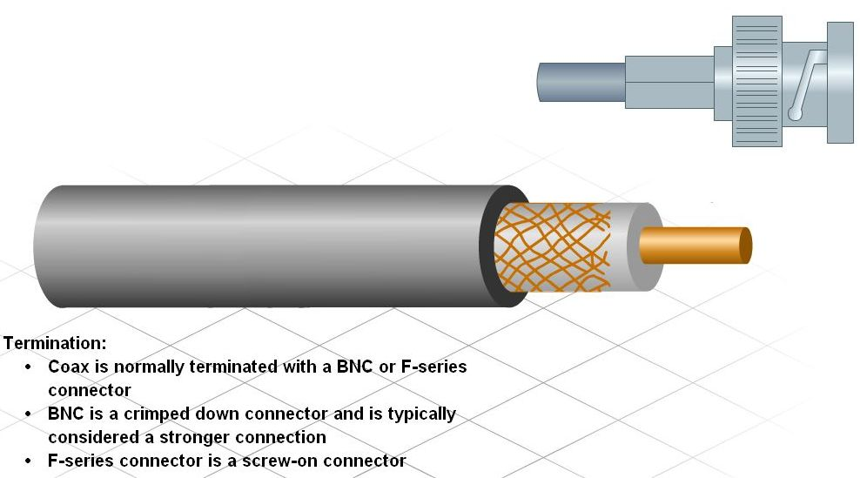
Types of Cables and Connectors Used in Networking
Describe Coax cable, common terminations, and when they are used

Slide 18
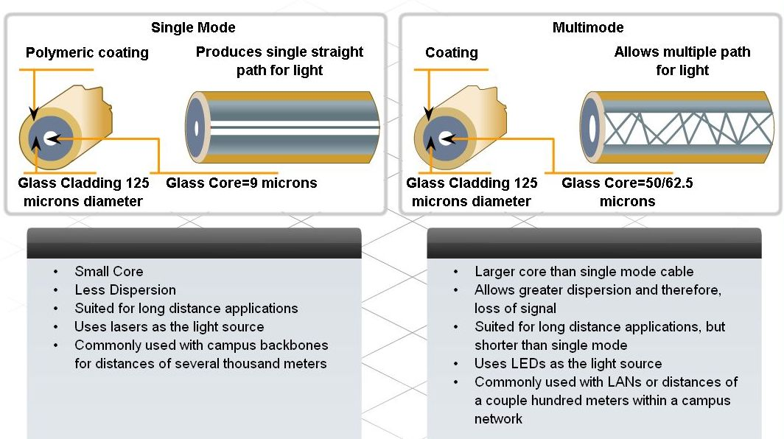
Types of Cables and Connectors Used in Networking
Describe optical fiber cables, common terminations, and when they are used

Slide 19
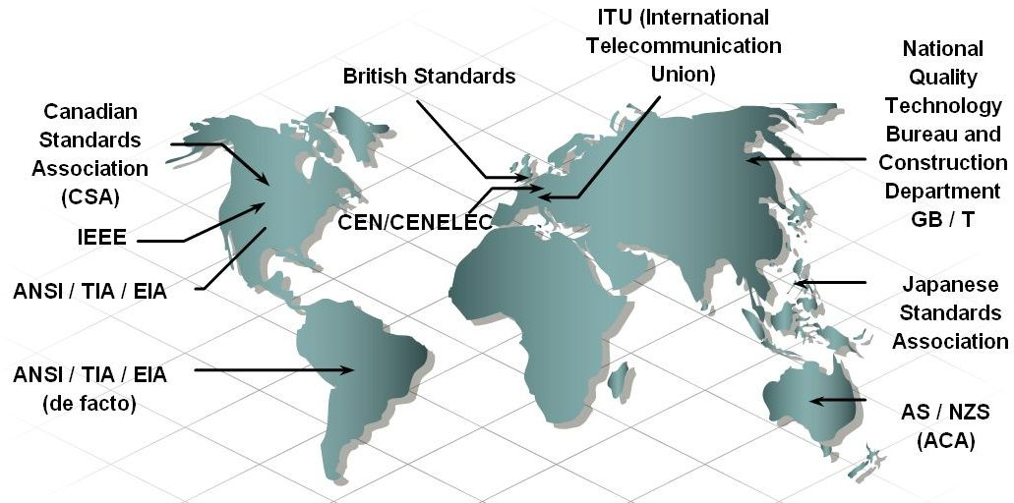
Construct and Terminate Twisted Pair Cables
Define cable standards and state their purpose

Slide 20
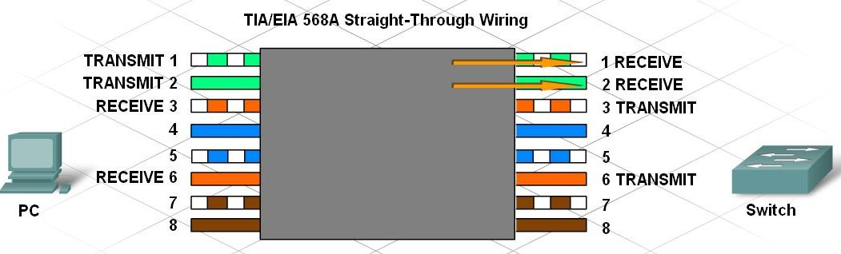
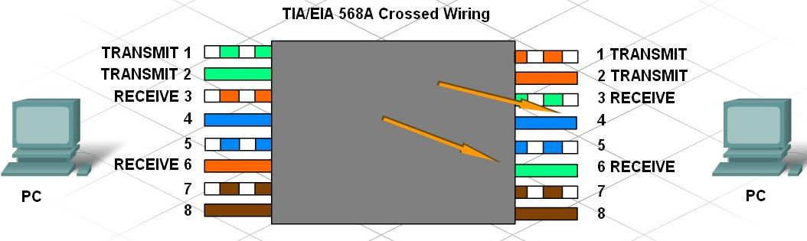
Construct and Terminate Twisted Pair Cables
Identify and describe the cross-over and straight through cable pinouts and color codes

Slide 21
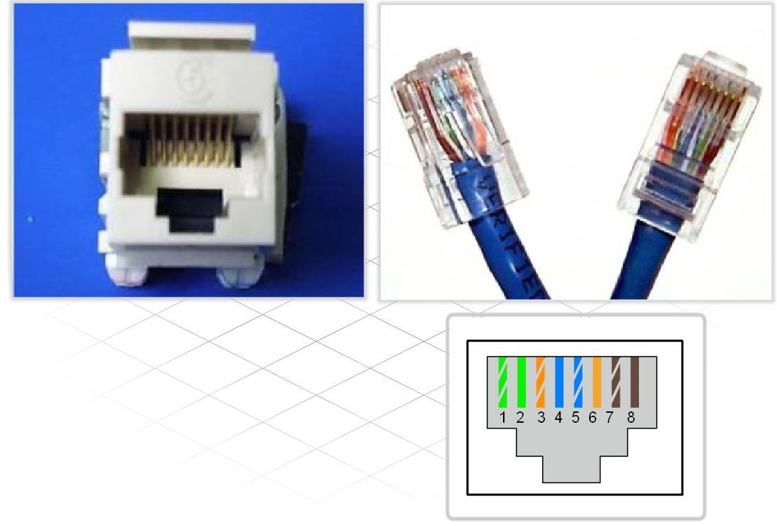
Construct and Terminate Twisted Pair Cables
Describe how to terminate UTP cables

Slide 22
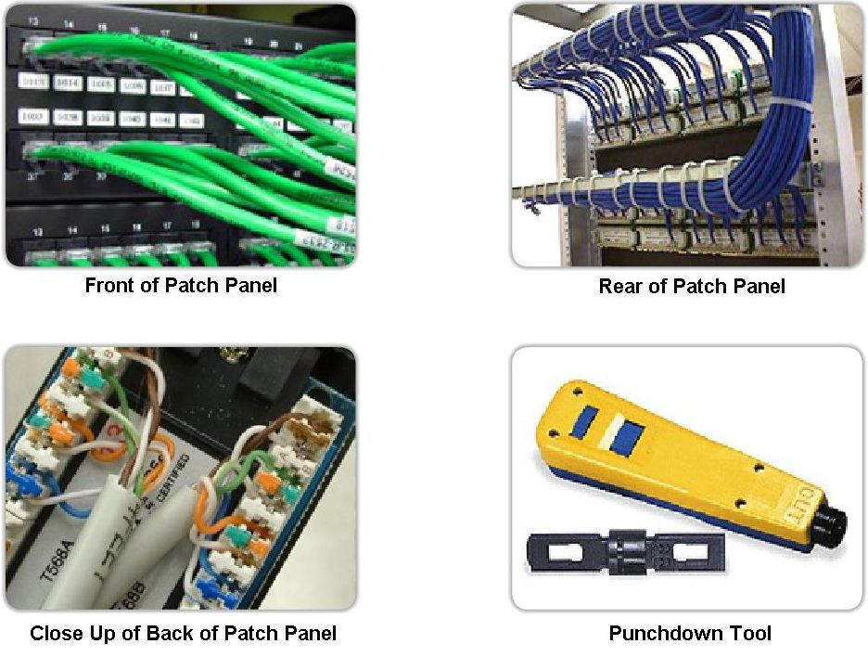
Construct and Terminate Twisted Pair Cables
Describe how to punch down wires to patch panel and wall jacks.

Slide 23
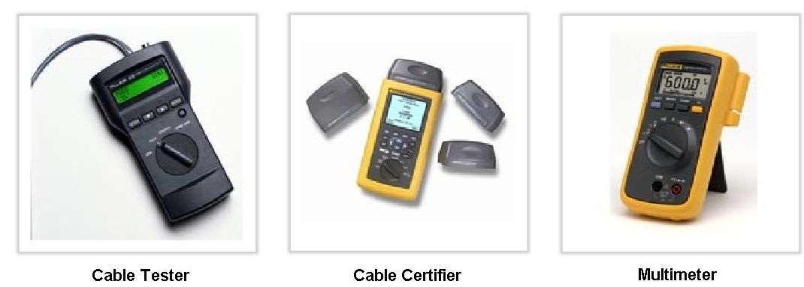
Construct and Terminate Twisted Pair Cables
Describe how to test cable termination and functionality (Cable testing).

Slide 24
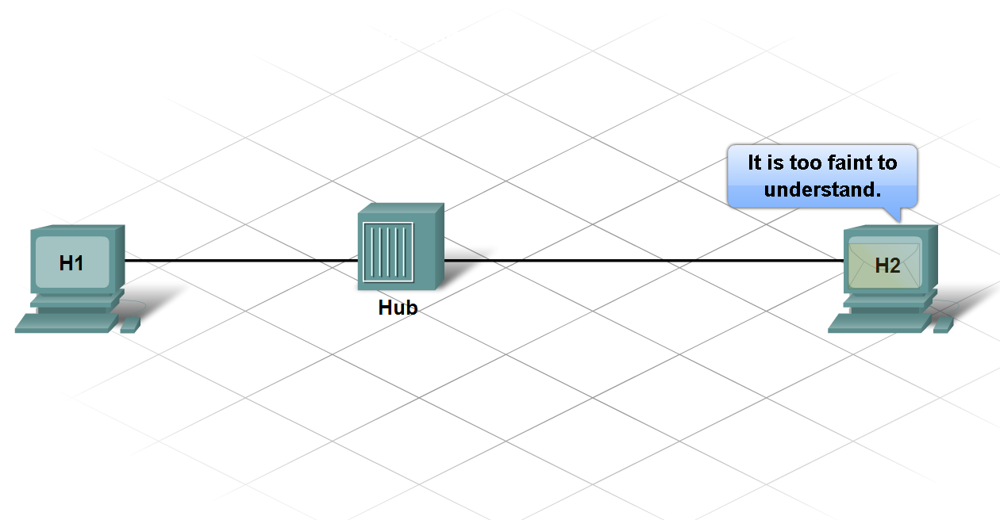
Construct and Terminate Twisted Pair Cables
Define Attenuation
Define Crosstalk

Slide 25
Construct and Terminate Twisted Pair Cables
Describe cabling best practices

Slide 26
Summary
The Internet is a worldwide collection of computer networks, accessed through ISPs.
Internet Protocol (IP) controls the structure and addressing of data packets for transport through the Internet cloud.
ISP Network Operations Centers (NOCs) utilize high-end, high-speed devices with redundancy.
Home networks feature multi-function devices which perform switching and routing.
Networks use physical cabling media which must conform to standards in construction and termination.
Cabling best practices are designed to reduce attenuation and crosstalk.

